Slide 1

6TH SEMESTER - COMPUTER GRAPHICS AND VISUALIZATION (18CS62) MODULE 2 FILL AREA PRIMITIVES, 2D GEOMETRIC TRANSFORMATIONS AND 2D VIEWING
Mr. SYED MATHEEN PASHA
ASSISTANT PROFESSOR
DEPARTMENT OF COMPUTER SCIENCE AND ENGINEERING
SAI VIDYA INSTITUTE OF TECHNOLOGY

Slide 2
Outline – Module 2
Fill area Primitives
Polygon fill-areas,
OpenGL polygon fill area functions,
fill area attributes,
general scan line polygon fill algorithm,
OpenGL fill-area attribute functions.
2D Geometric Transformations
Basic 2D Geometric Transformations,
matrix representations and homogeneous coordinates.
Inverse transformations,
2DComposite transformations,
other 2D transformations,
raster methods for geometric transformations,
OpenGL raster transformations,
OpenGL geometric transformations function,
2D viewing
2D viewing pipeline,
OpenGL 2D viewing functions.

Slide 3
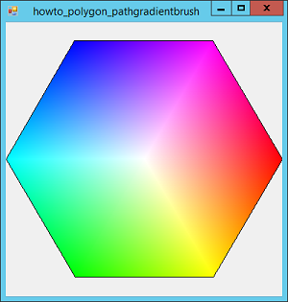
Fill area Primitives
A important component of a picture is an area that is filled with some solid color or pattern.
A picture component of this type is typically referred to as a Fill area
Fill areas are used to describe surfaces of solid objects, but they are also useful in a variety of other applications.
Also, fill regions are usually planar surfaces, mainly polygons.

Slide 4
Fill area Primitives
Fill area are specified as a polygon
Assume that all fill areas are to be displayed with a specified solid color.

Slide 5
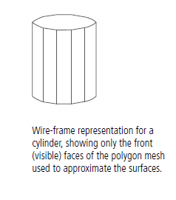
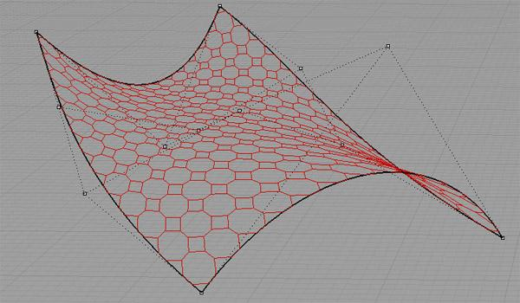
Fill area Primitives
Approximating a curved surface with polygon facets is sometimes referred to as surface tessellation, or fitting the surface with a polygon mesh.
Figure shows the side and top surfaces of a metal cylinder approximated in an outline form as a polygon mesh.

Slide 6
Polygon Fill Areas
Polygon
Plane figure specified by a set of three or more coordinate positions, called vertices, that are connected in sequence by straight-line segments, called the edges or sides of the polygon.

Slide 7
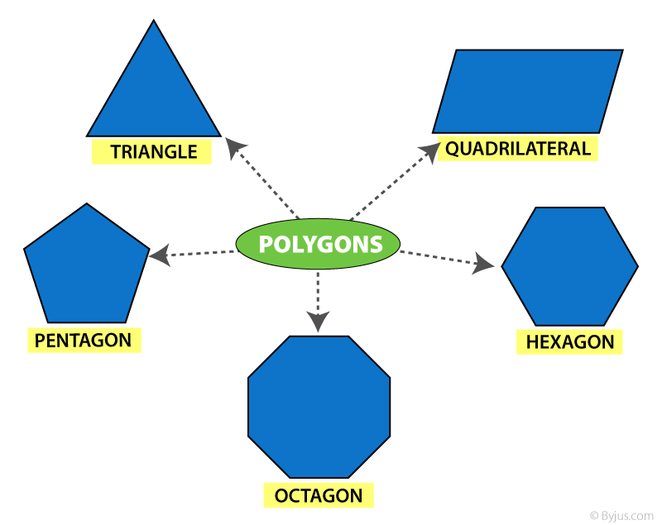
Polygon Fill Areas
Examples of polygons
triangles,
rectangles,
octagons,
decagons.

Slide 8
Polygon Fill Areas
Sometimes, any plane figure with a closed-polyline boundary is alluded to as a Polygon, and one with no crossing edges is referred to as a standard polygon or a simple polygon.

Slide 9
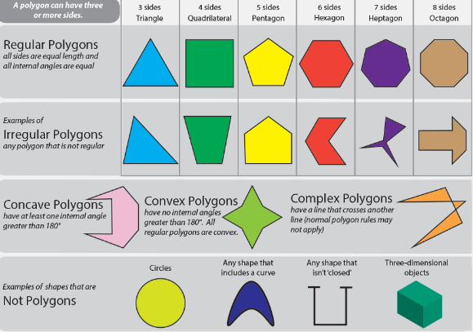

Slide 10
Polygon Fill Areas
Polygon Classifications
Convex polygon
Concave polygon
degenerate polygon

Slide 11
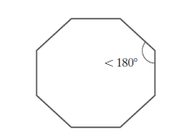
Polygon Fill Areas
Convex polygon
An interior angle of a polygon is an angle inside the polygon boundary that is formed by two adjacent edges.
If all interior angles of a polygon are less than or equal to 180◦, the polygon is convex.

Slide 12
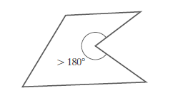
Polygon Fill Areas
A polygon that is not convex is called a concave polygon.

Slide 13


Polygon Fill Areas
Degenerate polygon
Is often used to describe a set of vertices that are collinear or that have repeated coordinate positions.
Degenerate polygon is also applied to a vertex list that contains fewer than three coordinate positions.

Slide 14
Polygon Fill Areas
Problems in concave polygon:
Implementations of fill algorithms and other graphics routines are more complicated
Solution:
It is generally more efficient to split a concave polygon into a set of convex polygons before processing

Slide 15
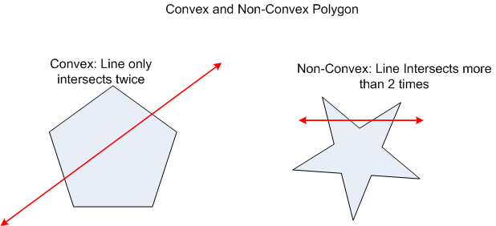
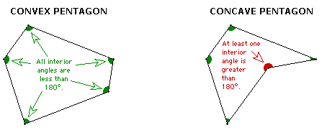
Polygon Fill Areas
Identifying Concave Polygons
A concave polygon has at least one interior angle greater than 180◦.
The extension of some edges of a concave polygon will intersect other edges
Some pair of interior points will produce a line segment that intersects the polygon boundary

Slide 16
Polygon Fill Areas
Identification algorithm 1
Identifying a concave polygon by calculating cross-products of successive pairs of edge vectors.
If we set up a vector for each polygon edge, then we can use the cross-product of adjacent edges to test for concavity.
All such vector products will be of the same sign (positive or negative) for a convex polygon.

Slide 17
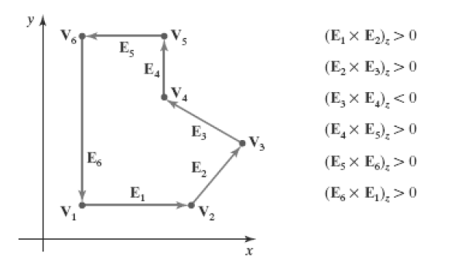
Polygon Fill Areas
if some cross-products yield a positive value and some a negative value, we have a concave polygon

Slide 18
Polygon Fill Areas
Identification algorithm 2
Look at the polygon vertex positions relative to the extension line of any edge.
If some vertices are on one side of the extension line and some vertices are on the other side, the polygon is concave.

Slide 19
Polygon Fill Areas
Splitting Concave Polygons
Once we have identified a concave polygon, we can split it into a set of convex polygons.
we assume that all polygons are in the xy plane.

Slide 20
Polygon Fill Areas
Different Methods to split concave to convex
edge vectors and edge cross-products
Rotational method
Splitting a Convex Polygon into a Set of Triangles

Slide 21
Polygon Fill Areas
1.Edge Vector Method
First need to form the edge vectors.
Given two consecutive vertex positions, V_{k} and V_{k+1}, we define the edge vector between them as E_{k} = V_{k+1} – V_{k}
Calculate the cross-products of successive edge vectors in order around the polygon perimeter.

Slide 22
Polygon Fill Areas
If the z component of some cross-products is positive while other cross-products have a negative z component, the polygon is concave.
We can apply the vector method by processing edge vectors in counterclockwise order If any cross-product has a negative z component (as in below figure), the polygon is
concave and we can split it along the line of the first edge vector in the cross-product pair

Slide 23
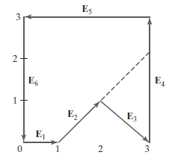
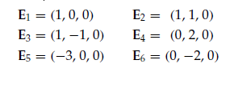
Polygon Fill Areas
Edge vectors for this polygon can be expressed as
E_{k} = V_{k+1} – V_{k}
z component is 0, since all edges are in the xy plane.

Slide 24
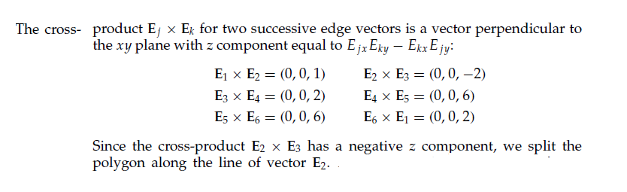
Polygon Fill Areas

Slide 25
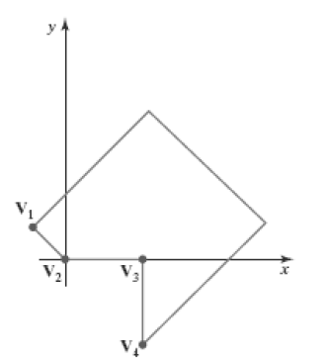
Polygon Fill Areas
2.Rotational method
Proceeding counterclockwise around the polygon edges,we shift the position of the polygon so that each vertex V_{k} in turn is at the coordinate origin.
We rotate the polygon about the origin in a clockwise direction so that the next vertex V_{k+1} is on the x axis.
If the following vertex, V_{k+2}, is below the x axis, the polygon is concave.
We then split the polygon along the x axis to form two
new polygons, and we repeat the concave test for
each of the two new polygons

Slide 26
Polygon Fill Areas
3.Splitting a Convex Polygon into a Set of Triangles
Once we have a vertex list for a convex polygon, we could transform it into a set of triangles.
First define any sequence of three consecutive vertices to be a new polygon (a triangle).
The middle triangle vertex is then deleted from the original vertex list .
The same procedure is applied to this modified vertex list to strip off another triangle.
We continue forming triangles in this manner until the original polygon is reduced to just three vertices, which define the last triangle in the set.

Slide 27
Polygon Fill Areas
Identifying interior and exterior region of polygon
To identify whether region is “interior” or “exterior”
Two commonly used algorithms
1. Odd-Even rule
2. The nonzero winding-number rule.

Slide 28
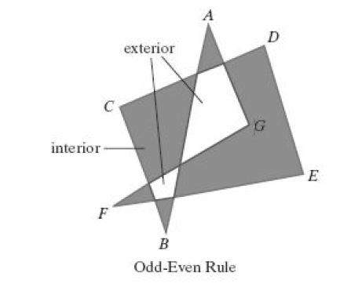
Polygon Fill Areas
Odd-Even rule

Slide 29
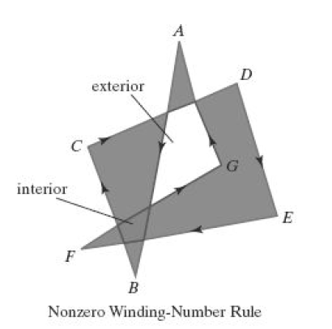
Polygon Fill Areas
The nonzero winding-number rule

Slide 30
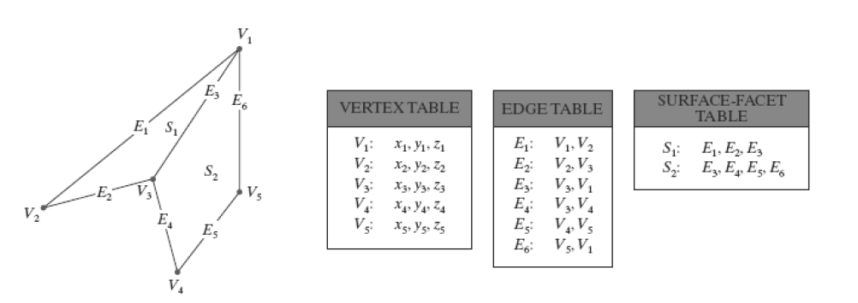
Polygon Fill Areas
Polygon Table
Coordinate values for each vertex in the object are stored in the vertex table.

Slide 31
Polygon Fill Areas
Plane Equations
Each polygon in a scene is contained within a plane of infinite extent.
The general equation of a plane is
Ax + B y + C z + D = 0
(x, y, z) is any point on the plane, and
A, B, C, and D (called plane parameters) are
constants describing the spatial properties of the plane.

Slide 32
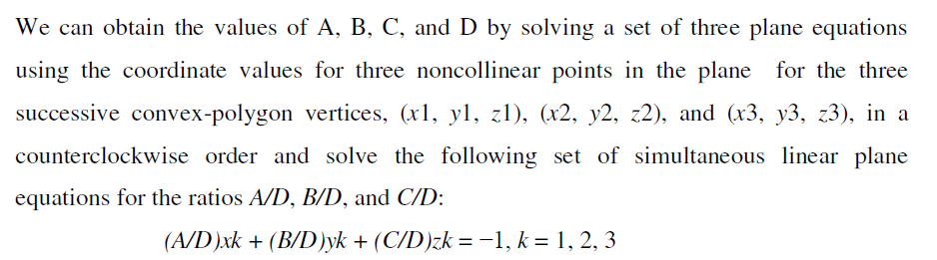
Polygon Fill Areas

Slide 33
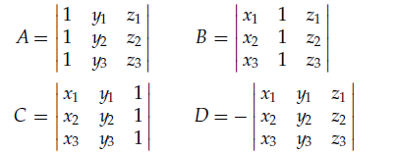
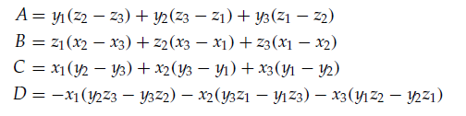
Polygon Fill Areas
Ax + B y + C z + D = 0

Slide 34
Polygon Fill Areas
Front and Back Polygon Faces
The side of a polygon that faces into the object interior is called the back face, and the visible, or outward, side is the front face
Every polygon is contained within an infinite plane that partitions space into two regions.

Slide 35
Polygon Fill Areas
Any point that is not on the plane and that is visible to the front face of a polygon surface section is said to be in front of (or outside) the plane, and, thus, outside the object.
And any point that is visible to the back face of the polygon is behind (or inside) the plane.

Slide 36

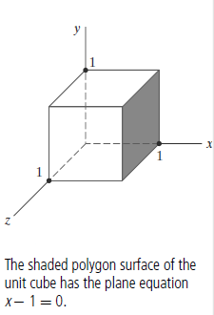
Polygon Fill Areas

Slide 37
OpenGL Polygon Fill-Area Functions
OpenGL procedures for specifying fill polygons is described with a list of vertices placed between a
glBegin/glEnd pair

Slide 38
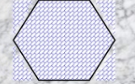
OpenGL Polygon Fill-Area Functions
Polygon interior is displayed in a solid color
Fill a polygon with a pattern and we can display polygon edges as line borders around the interior fill.
There are six different symbolic constants that we can use as the argument in the glBegin function to describe polygon fill areas.

Slide 39
OpenGL Polygon Fill-Area Functions
There are six different symbolic constants
GL_POLYGON
GL_TRIANGLES
GL_ TRIANGLE_ STRIP
GL_TRIANGLE_ FAN
GL _QUADS
GL _QUAD_ STRIP

Slide 40
OpenGL Polygon Fill-Area Functions
A polygon vertex list must contain at least three vertices. Otherwise, nothing is displayed.

Slide 41
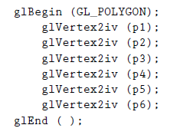
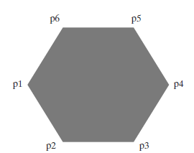
OpenGL Polygon Fill-Area Functions
GL_ POLYGON
List of six points, labeled p1 through p6, specifying two-dimensional polygon vertex positions in a counterclockwise ordering.
Each of the points is represented as an array of (x, y) coordinate values
int p1 [ ] = {50, 100};
int p2 [ ] = {75, 150};
int p3 [ ] = {100, 200};
int p4 [ ] = {150, 200};
int p5 [ ] = {200, 350};
int p6 [ ] = {220, 300};

Slide 42
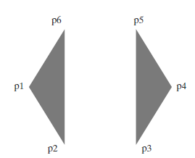
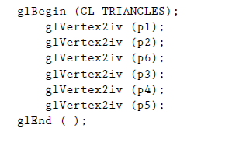
OpenGL Polygon Fill-Area Functions
GL_TRIANGLES,
If we reorder the vertex list and change the primitive constant in the previous code example to GL_TRIANGLES, we obtain the two separated triangle fill areas

Slide 43
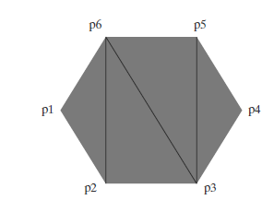
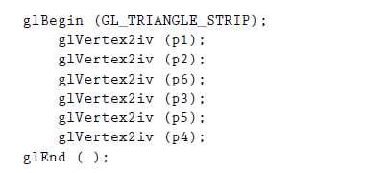
GL_ TRIANGLE _STRIP
By reordering the vertex list once more and changing the primitive constant to
GL_ TRIANGLE _STRIP, we can display the set of connected triangles

Slide 44
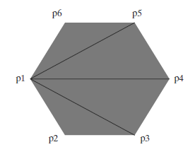
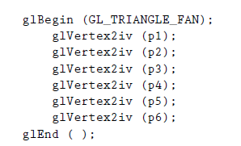
GL_TRIANGLE_ FAN
Another way to generate a set of connected triangles is to use the “fan” , where all triangles share a common vertex.
We obtain this arrangement of triangles using the primitive constant GL_TRIANGLE_ FAN and the original ordering of our six vertices are

Slide 45
OpenGL provides specifications for two types of quadrilaterals (four-sided polygons)
GL _QUADS
GL _QUAD_ STRIP

Slide 46
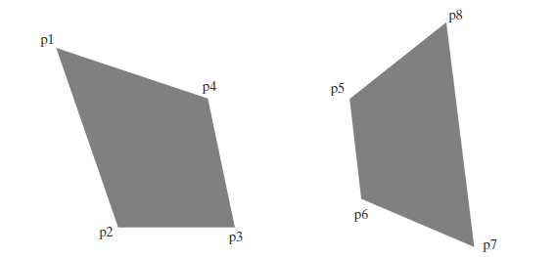
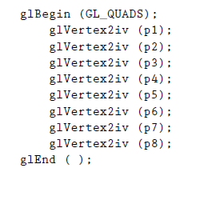
GL_QUADS
With the GL _QUADS primitive constant and the following list of eight vertices, specified as two-dimensional coordinate arrays, we can generate the display shown in Figure

Slide 47
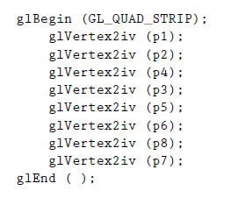
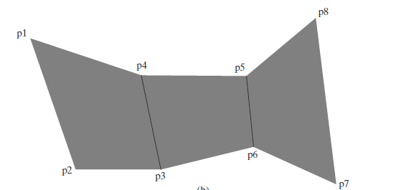
GL _QUAD_ STRIP
Rearranging the vertex list and changing the primitive constant to GL_QUAD_ STRIP, we can obtain the set of connected quadrilaterals shown in Figure

Slide 48
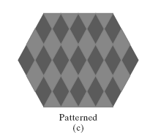
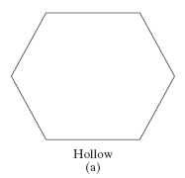
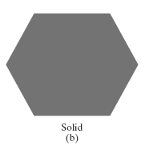
Fill area attributes
Fill Styles
Fill-area attribute
a “hollow” style
a single color
a specified fill pattern

Slide 49
Fill area attributes
We can also fill selected regions of a scene using various brush styles, color-blending combinations, or textures.
For polygons,
we could show the edges in different colors, widths, and styles
we can select different display attributes for the front and back faces of a region.

Slide 50
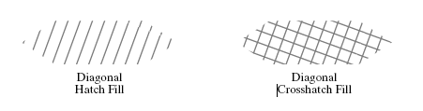
Fill area attributes
This process of filling an area with a rectangular pattern is called tiling, and a rectangular fill pattern is sometimes referred to as a tiling pattern predefined fill patterns are available in a system, such as the hatch fill patterns

Slide 51
General Scan-Line Polygon-Fill Algorithm
A scan-line fill of a region is performed by first determining the intersection positions of the boundaries of the fill region with the screen scan lines.
Then the fill colors are applied to each section of a scan line that lies within the interior of the fill region.
The simplest area to fill is a polygon because each scanline intersection point with a polygon boundary is obtained by solving a pair of simultaneous linear equations, where the equation for the scan line is simply y = constant.

Slide 52
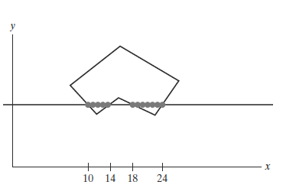
General Scan-Line Polygon-Fill Algorithm
Scan Line Procedure
For each scan line that crosses the polygon, the edge intersections are sorted from left to right, and then the pixel positions between, and including, each intersection pair are set to the specified fill color
five pixels from x = 10 to x = 14 and to the seven pixels from x = 18 to x = 24.

Slide 53
General Scan-Line Polygon-Fill Algorithm
Whenever a scan line passes through a vertex, it intersects two polygon edges at that point.

Slide 54
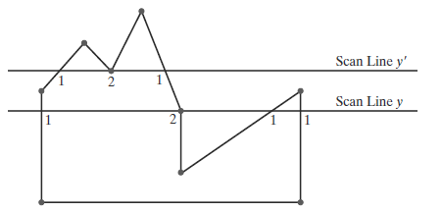
General Scan-Line Polygon-Fill Algorithm
Scan line y’ intersects an even number of edges, and the two pairs of intersection points along this scan line correctly identify the interior pixel spans.
scan line y intersects five polygon edges.

Slide 55
General Scan-Line Polygon-Fill Algorithm
Thus, as we process scan lines, we need to distinguish between these cases.

Slide 56
General Scan-Line Polygon-Fill Algorithm
To Identify the intersection point
Scan line y the two edges sharing an intersection vertex are on opposite sides of the scan line.
Scan line y’ the two intersecting edges are both above the scan line.

Slide 57
General Scan-Line Polygon-Fill Algorithm
We can identify these vertices by tracing around the polygon boundary in either clockwise or counterclockwise order and observing the relative changes in vertex y coordinates as we move from one edge to the next.

Slide 58
General Scan-Line Polygon-Fill Algorithm
If the three endpoint y values of two consecutive edges monotonically increase or decrease, we need to count the shared (middle) vertex as a single intersection point for the scan line passing through that vertex.

Slide 59
General Scan-Line Polygon-Fill Algorithm
One method for implementing the adjustment to the vertex-intersection count is to shorten some polygon edges to split those vertices that should be counted as one intersection.

Slide 60
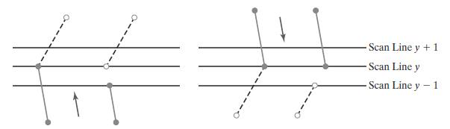
General Scan-Line Polygon-Fill Algorithm
When the endpoint y coordinates of the two edges are increasing, the y value of the upper endpoint for the current edge is decreased by 1
When the endpoint y values are monotonically decreasing, we decrease the y coordinate of the upper endpoint of the edge following the current edge.

Slide 61
General Scan-Line Polygon-Fill Algorithm
Coherence properties can be used in computer-graphics algorithms to reduce processing.
Coherence methods often involve incremental calculations applied along a single scan line or between successive scan lines

Slide 62
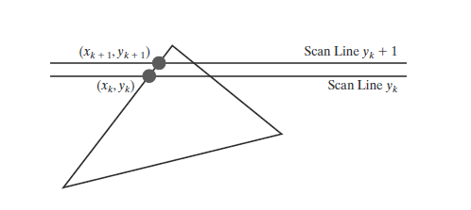

General Scan-Line Polygon-Fill Algorithm
The slope of this edge can be expressed in terms of the scan-line intersection coordinates:

Slide 63


General Scan-Line Polygon-Fill Algorithm
Because the change in y coordinates between the two scan lines is simply
x-intersection value x_{k+1} on the upper scan line can be determined from the x-intersection value x_{k} on the preceding scan line as

Slide 64


General Scan-Line Polygon-Fill Algorithm
Each successive x intercept can thus be calculated by adding the inverse of the slope and rounding to the nearest integer.
Along an edge with slope m, the intersection x_{k} value for scan line k above the initial scan line can be calculated as
m is the ratio of two integers, Where Δx and Δy are the differences between the edge endpoint x and y coordinate values.

Slide 65

General Scan-Line Polygon-Fill Algorithm
Thus, incremental calculations of x intercepts along an edge for successive scan lines can be expressed as

Slide 66
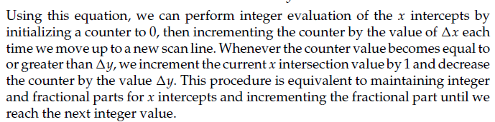
General Scan-Line Polygon-Fill Algorithm

Slide 67
General Scan-Line Polygon-Fill Algorithm
To perform a polygon fill efficiently,
store the polygon boundary in a sorted edge table that contains all the information necessary to process the scan lines efficiently.
Proceeding around the edges in either a clockwise or a counterclockwise order, we can use a bucket sort to store the edges, sorted on the smallest y value of each edge, in the correct scan-line positions.

Slide 68
General Scan-Line Polygon-Fill Algorithm
Only nonhorizontal edges are entered into the sorted edge table.
4. Each entry in the table for a particular scan line contains the
maximum y value for that edge,
x-intercept value (at the lower vertex) for the edge,
inverse slope of the edge.
For each scan line, the edges are in sorted order from left to right

Slide 69
General Scan-Line Polygon-Fill Algorithm
5. Process the scan lines from the bottom of the polygon to its top, producing an active edge list for each scan line crossing the polygon boundaries.
6. The active edge list for a scan line contains all edges crossed by that scan line, with iterative coherence calculations used to obtain the edge intersections

Slide 70
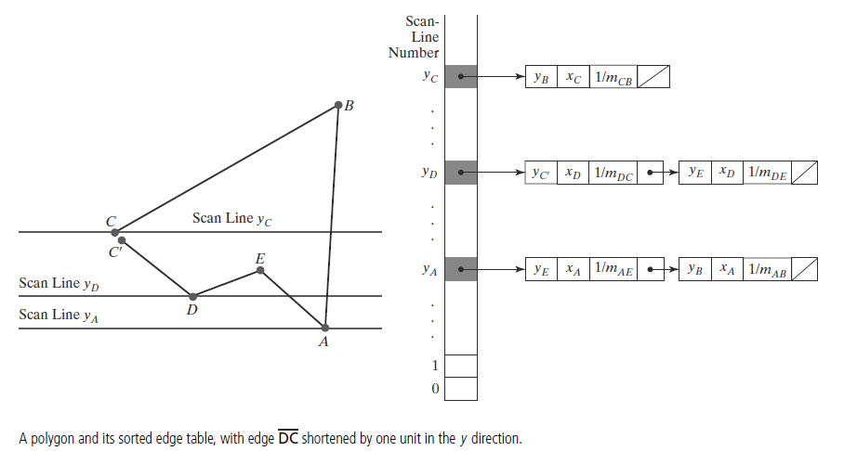
General Scan-Line Polygon-Fill Algorithm

Slide 71
Outline – Module 2
Fill area Primitives
Polygon fill-areas,
OpenGL polygon fill area functions,
fill area attributes,
general scan line polygon fill algorithm,
OpenGL fill-area attribute functions.
2D Geometric Transformations
Basic 2D Geometric Transformations,
matrix representations and homogeneous coordinates.
Inverse transformations,
2DComposite transformations,
other 2D transformations,
raster methods for geometric transformations,
OpenGL raster transformations,
OpenGL geometric transformations function,
2D viewing
2D viewing pipeline,
OpenGL 2D viewing functions.

Slide 72
Basic geometric transformations
Translation
Rotation
Scaling

Slide 73
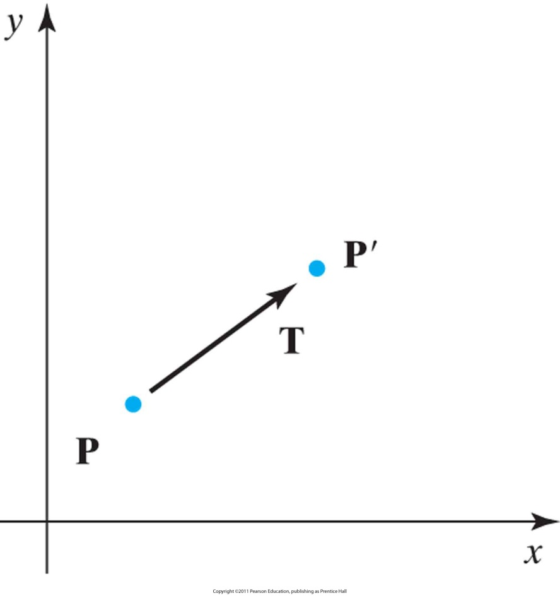

2D translation
To translate a two-dimensional position, we add translation distances t_{x} and t_{y} to the original coordinates (x, y) to obtain the new coordinate position (x’, y’)
as shown in Figure .
The translation distance pair (t_{x} , t_{y}) is called a translation vector or shift vector.
Translating a point from position P to position P’ using a translation vector T.

Slide 74
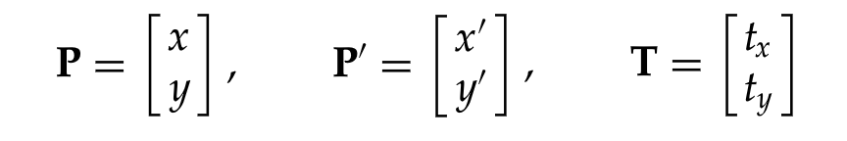

2D translation equations
We can express above Equations as a single matrix equation by using the following
column vectors to represent coordinate positions and the translation vector:
This allows us to write the two-dimensional translation equations in the matrix
form
Translation is a rigid-body transformation: Objects are moved without
deformation.

Slide 75
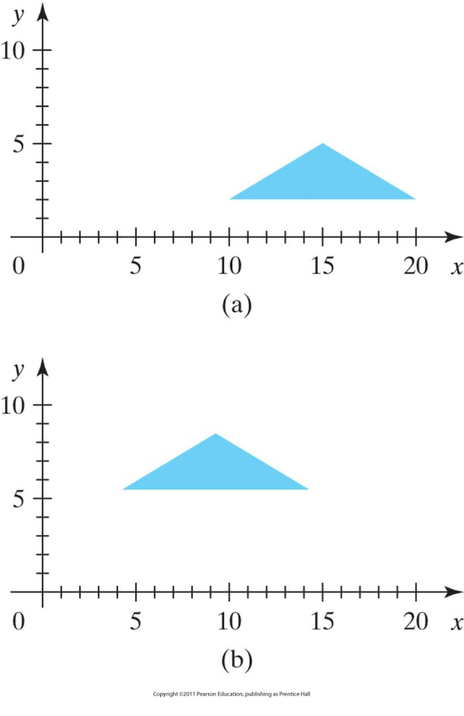
2D translation example
Figure : Moving a polygon from position (a) to position (b) with the translation vector (−5.50, 3.75).

Slide 76
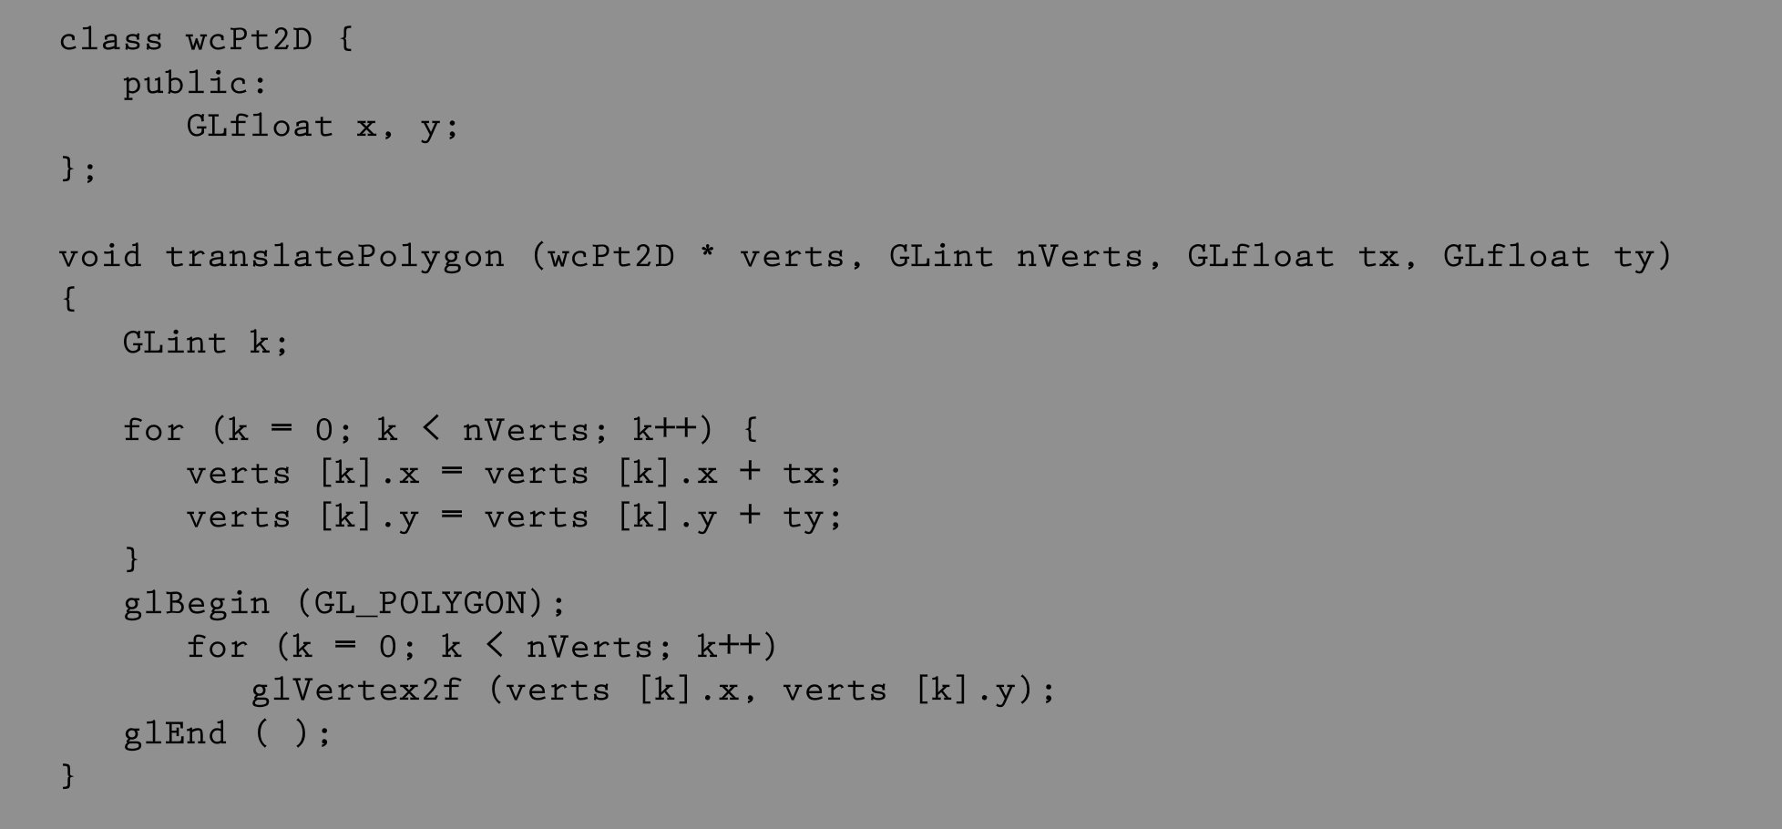
2D translation example program

Slide 77
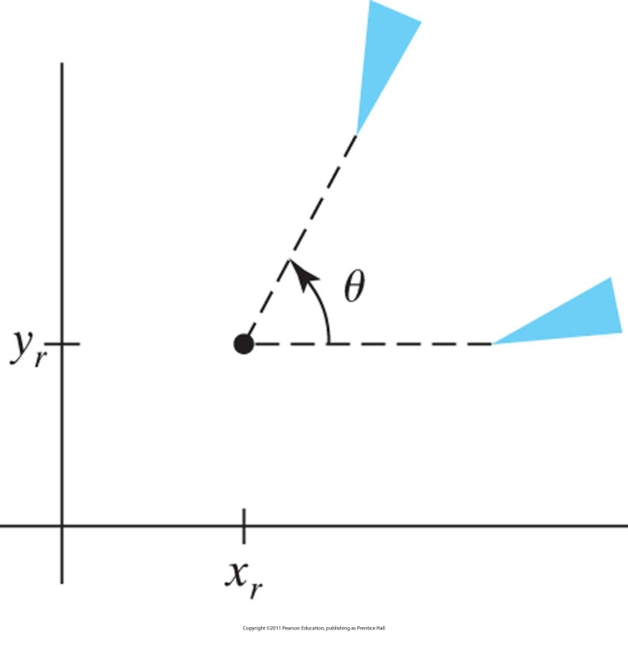
2D rotation
All points of the object are transformed to new positions by rotating the points through a specified rotation angle about the rotation axis (in 2D, rotation pivot or pivot point)
Figure : Rotation of an object through angle θ about the pivot point (x_{r} , y_{r} ).

Slide 78
2D rotation
The pivot point is the intersection position of the rotation axis with the xy plane.
A positive value for the angle θ defines a counterclockwise rotation about the pivot point,
A negative value rotates objects in the clockwise direction.

Slide 79
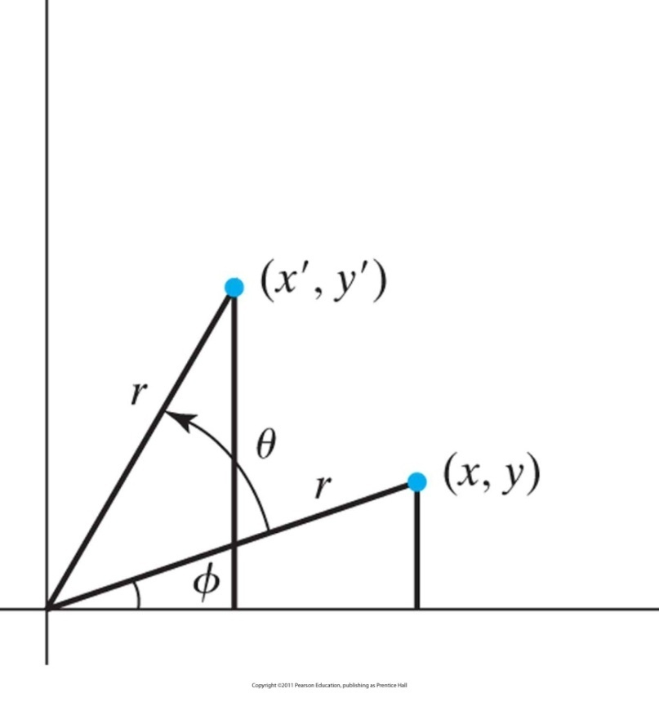

2D rotation
Setting
we have
Figure: Rotation of a point from position (x, y ) to position (x', y' ) through an angle θ relative to the coordinate origin.
The original angular displacement of the point from the x axis is Φ.

Slide 80

2D rotation
Figure: Rotation of a point from position (x, y ) to position (x', y' ) through an angle θ relative to the coordinate origin.
The original angular displacement of the point from the x axis is Φ.

Slide 81


2D rotation in matrix form
Equations can be compactly expressed in matrix form:
Rotation is a rigid-body transformation: Objects are moved without
deformation.

Slide 82


Rotation about a general pivot point
Figure 7-5 Rotating a point from position (x , y ) to position (x' , y' ) through an angle θ about rotation point (x_{r} , y_{r} ).

Slide 83

2D rotation example
// Make necessary allocations!!

Slide 84



2D scaling
s_{x} and s_{y} are scaling factors
s_{x} scales an object in x direction
s_{y} scales an object in y direction
If s_{x}=s_{y}, we have uniform scaling: Object proportions are maintained.
If s_{x}≠s_{y}, we have differential scaling.
Negative scaling factors resizes and reflects the object about one or more
of the coordinate axes.

Slide 85

2D scaling
Figure 7-6 Turning a square (a) into a rectangle (b) with scaling factors s_{x} = 2 and s_{y} = 1.
Scaling factors greater than 1 produce
enlargements.

Slide 86

2D scaling
Figure 7-7 A line scaled with Equation 7-12 using s_{x} = s_{y} = 0.5 is reduced in size and moved closer to the coordinate origin.
Positive scaling values less than 1 reduce the size of objects.

Slide 87

Scaling relative to a fixed point
Figure 7-8 Scaling relative to a chosen fixed point (x_{f} , y_{f} ). The distance from each polygon vertex to the fixed point is scaled by Equations 7-13.
Fixed point remains
unchanged after the
scaling transformation.

Slide 88

2D scaling relative to a fixed point

Slide 89

2D scaling example
// Make necessary allocations!!

Slide 90

Matrix representations and homogeneous coordinates
Multiplicative and translational terms for a 2D transformation can be combined into a single matrix
This expands representations to 3x3 matrices
Third column is used for translation terms
Result: All transformation equations can be expressed as matrix multiplications
Homogeneous coordinates: (x_{h}, y_{h}, h)
Carry out operations on points and vectors “homogeneously”
h: Non-zero homogeneous parameter such that
We can also write: (hx, hy, h)
h=1 is a convenient choice so that we have (x, y, 1)
Other values of h are useful in 3D viewing transformations

Slide 91


2D translation matrix

Slide 92


2D rotation matrix

Slide 93


2D scaling matrix

Slide 94



Inverse transformations
Inverse translation
Inverse rotation
Inverse scaling

Slide 95



Composite transformations
Composite transformation matrix is formed by calculating the product of individual transformations
Successive translations (additive)

Slide 96




Composite transformations
Successive rotations (additive)
Successive scaling (multiplicative)

Slide 97

2D pivot-point rotation
Figure 7-9 A transformation sequence for rotating an object about a specified pivot point using the rotation matrix R(θ) of transformation 7-19.

Slide 98


2D pivot-point rotation
Note the order of operations:

Slide 99

2D fixed-point scaling
Figure 7-10 A transformation sequence for scaling an object with respect to a specified fixed position using the scaling matrix S(s_{x} , s_{y} ) of transformation 7-21.

Slide 100

2D fixed-point scaling

Slide 101
Matrix concatenation properties
Multiplication is associative
Multiplication is NOT commutative
Unless the sequence of transformations are all of the same kind
M₂M₁ is not equal to M₁M₂ in general

Slide 102
Computational efficiency
Formulation of a concatenated matrix may be more efficient
Requires fewer multiply/add operations
Rotation calculations require trigonometric evaluations
In animations with small-angle rotations, approximations (e.g. power series) and iterative calculations can reduce complexity

Slide 103


Other transformations: reflection
Figure 7-16 Reflection of an object about the x axis.

Slide 104


Reflection
Figure 7-17 Reflection of an object about the y axis.

Slide 105


Reflection
Figure 7-18 Reflection of an object relative to the coordinate origin. This transformation can be accomplished with a rotation in the xy plane about the coordinate origin.

Slide 106

Reflection
Figure 7-19 Reflection of an object relative to an axis perpendicular to the xy plane and passing through point P_{reflect}.

Slide 107


Reflection
Figure 7-20 Reflection of an object with respect to the line y = x .

Slide 108


Other transformations: shear
Distorts the shape of an object such that the transformed shape appears as if the object were composed of internal layers that had been caused to slide over each other
Figure 7-23 A unit square (a) is converted to a parallelogram (b) using the x -direction shear matrix 7-57 with sh_{x} = 2.

Slide 109


Shear
Figure 7-24 A unit square (a) is transformed to a shifted parallelogram (b) with sh_{x} = 0.5 and y_{ref} = −1 in the shear matrix 7-59.

Slide 110


Shear
Figure 7-25 A unit square (a) is turned into a shifted parallelogram (b) with parameter values sh_{y} = 0.5 and x_{ref} = −1 in the y -direction shearing transformation 7-61.

Slide 111
Raster Methods for Geometric Transformations
Raster systems store picture information as color patterns in the frame buffer.
Object transformations can be carried out rapidly by manipulating an array of pixel values
Few arithmetic operations are needed,
Functions that manipulate rectangular pixel arrays are called raster operations
Moving a block of pixel values from one position to another is termed a block transfer, a bitblt, or a pixblt.

Slide 112


Raster Methods for Geometric Transformations
2D Translation

Slide 113


Raster Methods for Geometric Transformations
2D Rotation

Slide 114

Raster Methods for Geometric Transformations
2D Scaling
Mapping destination Pixel areas onto scaled array of pixel .
Scaling parameter sx and sy =0.5
Are applied to relative point ( xf, yf)

Slide 115
OpenGL Raster Transformations
Translation
A translation of a rectangular array of pixel-color values from one buffer area to another
can be accomplished in OpenGL as the following copy operation:
glCopyPixels (xmin, ymin, width, height, GL_COLOR);
The first four parameters in this function give the location and dimensions of the pixel block;
OpenGL symbolic constant GL_COLOR specifies that it is color values are to be copied.

Slide 116
OpenGL Raster Transformations
Rotation
Save the block of pixel in an array.
A block of RGB color values in a buffer can be saved in an array with the function
glReadPixels (xmin, ymin, width, height, GL_RGB, GL_UNSIGNED_BYTE, colorArray);

Slide 117
OpenGL Raster Transformations
Rotation
To put the rotated array back in the buffer
glDrawPixels (width, height, GL_RGB, GL_UNSIGNED_BYTE, colorArray);

Slide 118
OpenGL Raster Transformations
Scaling
We can set scaling parameter
glPixelZoom (sx, sy);

Slide 119
OpenGL Functions for Two-Dimensional Geometric Transformations
Transformation routine sets up a 4 × 4 matrix that is applied to the coordinates of objects
Translation, we invoke the translation routine and set the components for the three-dimensional translation vector.
Rotation function, we specify the angle and the orientation for a rotation axis that intersects the coordinate origin.
Scaling function is used to set the three coordinate scaling factors relative to the coordinate origin.

Slide 120
OpenGL Functions for Two-Dimensional Geometric Transformations
Translation, we invoke the translation routine and set the components for the three-dimensional translation vector.
glTranslate* (tx, ty, tz);
example: glTranslatef (25.0, -10.0, 0.0);

Slide 121
OpenGL Functions for Two-Dimensional Geometric Transformations
Rotation function, we specify the angle and the orientation for a rotation axis that intersects the coordinate origin.
glRotate* (theta, vx, vy, vz);
glRotatef (90.0, 0.0, 0.0, 1.0);

Slide 122
OpenGL Functions for Two-Dimensional Geometric Transformations
Scaling function is used to set the three coordinate scaling factors relative to the coordinate origin.
glScale* (sx, sy, sz);
glScalef (2.0, -3.0, 1.0);

Slide 123
OpenGL Functions for Two-Dimensional Geometric Transformations
OpenGL Matrix Operations
glMatrixMode (GL_MODELVIEW);
glLoadIdentity ( );
glMultMatrix function can also be used to set up any transformation sequence with individually defined matrices.

Slide 124
Outline – Module 2
Fill area Primitives
Polygon fill-areas,
OpenGL polygon fill area functions,
fill area attributes,
general scan line polygon fill algorithm,
OpenGL fill-area attribute functions.
2D Geometric Transformations
Basic 2D Geometric Transformations,
matrix representations and homogeneous coordinates.
Inverse transformations,
2DComposite transformations,
other 2D transformations,
raster methods for geometric transformations,
OpenGL raster transformations,
OpenGL geometric transformations function,
2D viewing
2D viewing pipeline,
OpenGL 2D viewing functions.

Slide 125

2D viewing pipeline
Clipping window: section of 2D scene selected for display
Viewport: window where the scene is to be displayed on the output device

Slide 126

2DViewing pipeline
Two-dimensional viewing-transformation pipeline.
Normalization makes viewing device independent
Clipping can be applied to object descriptions in normalized coordinates

Slide 127
OpenGL 2D viewing functions
OpenGL Library has no functions specifically for 2D Viewing
Core library GL contains
viewport functions
GLU library contains
2d Clipping window
GLUT library contains
Function for handling 2D display window

Slide 128


OpenGL 2D viewing functions
OpenGL Projection Mode
Before we select a clipping window and a viewport in OpenGL,
we need to establish the appropriate mode for constructing the matrix to transform from world coordinates to device coordinates.
This ensures that each time we enter the projection mode, the matrix will be reset to the identity matrix so that the new viewing parameters are not combined with the previous ones

Slide 129


OpenGL 2D viewing functions
GLU clipping-window function
To define a two-dimensional clipping window, we can use the GLU function:

Slide 130
OpenGL 2D viewing functions
GLU clipping-window function
If we do not specify a clipping window in an application program, the default coordinates
are (xwmin, ywmin) = (−1.0, −1.0) and (xwmax, ywmax) = (1.0, 1.0).
Thus the default clipping window is the normalized square centered on the coordinate origin with a side length of 2.0.

Slide 131

OpenGL 2D viewing functions
OpenGL viewport function
We specify the viewport parameters with the OpenGL function
xvmin and yvmin specify the position of the lowerleft corner of the viewport relative to the lower-left corner of the display window,
vpWidth and vpHeight are pixel width and height of the viewport
Coordinates for the upper-right corner of the viewport are calculated for this
transformation matrix in terms of the viewport width and height:

Slide 132
OpenGL 2D viewing functions
OpenGL viewport function
If we do not invoke the glViewport function in a program, the default Viewport size and position are the same as the size and position of the display window

Slide 133


OpenGL 2D viewing functions
Creating a GLUT Display Window
GLUT routines for creating and manipulating display windows so that our example programs
will be independent of any specific machine.

Slide 134

OpenGL 2D viewing functions
Setting the GLUT Display-Window Mode and Color

Slide 135

OpenGL 2D viewing functions
GLUT Display-Window Identifier
Multiple display windows can be created for an application, and each is assigned a positive-integer display-window identifier, starting with the value 1 for the first window that is created.

Slide 136
OpenGL 2D viewing functions
Deleting a GLUT Display Window
If we know the display window’s identifier, we can eliminate it with the statement
glutDestroyWindow (windowID);

Slide 137

OpenGL 2D viewing functions
Current GLUT Display Window
When we specify any display-window operation, it is applied to the current display window, which is either the last display window that we created or the one.

Slide 138

OpenGL 2D viewing functions
Relocating and Resizing a GLUT Display Window.

Slide 139
OpenGL 2D viewing functions
Relocating and Resizing a GLUT Display Window.
Whenever the size of a display window is changed, its aspect ratio may change and objects may be distorted from their original shapes.
We can adjust for a change in display-window dimensions using the statement
glutReshapeFunc (winReshapeFcn);

Slide 140

OpenGL 2D viewing functions
Managing Multiple GLUT Display Windows

Slide 141

OpenGL 2D viewing functions
Managing Multiple GLUT Display Windows

Slide 142

OpenGL 2D viewing functions
Managing Multiple GLUT Display Windows

Slide 143

OpenGL 2D viewing functions
GLUT Subwindows

Slide 144

OpenGL 2D viewing functions
Selecting a Display-Window Screen-Cursor Shape

Slide 145

OpenGL 2D viewing functions
Viewing Graphics Objects in a GLUT Display Window

Slide 146

OpenGL 2D viewing functions
Viewing Graphics Objects in a GLUT Display Window

Slide 147

OpenGL 2D viewing functions
Executing the Application Program

Slide 148

OpenGL 2D viewing functions
Other GLUT Functions

Slide 149

OpenGL 2D viewing functions
Other GLUT Functions

Slide 150
END

